Slide 1
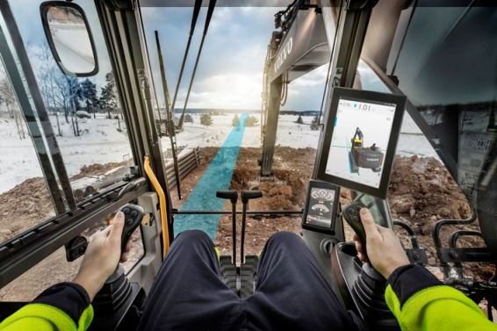
Co Pilot driver statistics project
11/18/2016
Team members:
Vladimir Djukanovic
Leslie Dahlberg
Léa Brunschwig
Eric Engtorp
Fredrik Frenning
Pooria Ghavamian
Hamza Sabljakovic

Slide 2
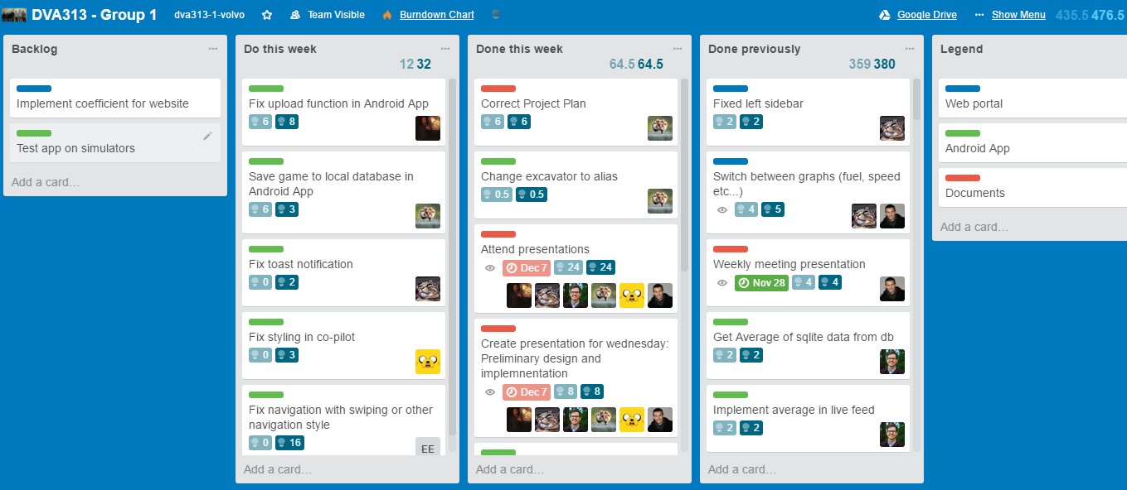
Trello – last week

Slide 3
Last week - establishments
Documentation
Weekly meeting presentation
Create presentation – Preliminary design and implementation
Correct project plan
Implementation:
Web application
Fix update handler
Android application
Fix images in App
Fix game screen layout – CoPilot
Test can bus reader
Change excavator to alias
Fix toast notification

Slide 4
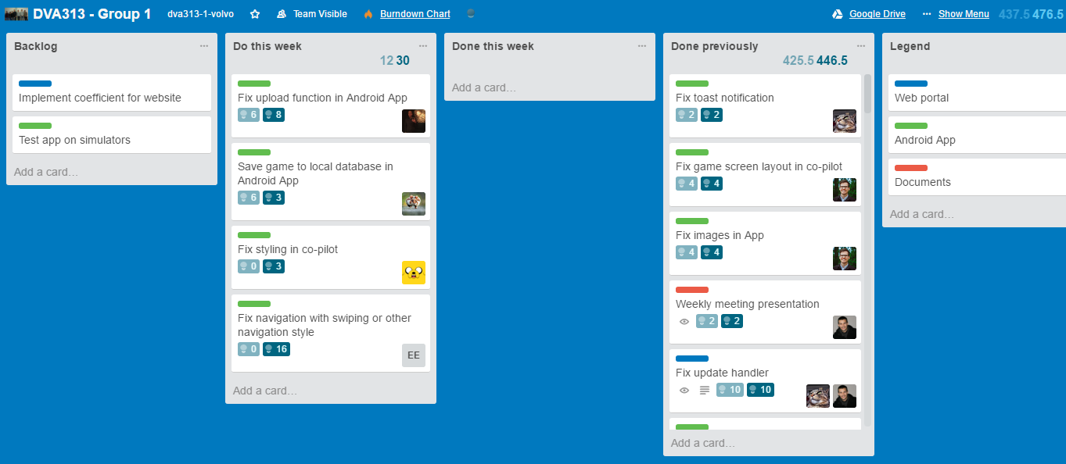
Trello – following week

Slide 5
Plan for following week
Volvo meeting
Android application implementation:
Fix upload function in Android App
Save game to local database in Android App
Fix navigation with swiping or other navigation style
Fix styling in co-pilot

Slide 6
Obstacles
Simulation machines

Slide 7
Worked hours
Name | Last week | Total
Vladimir Djukanovic | 16 | 94
Hamza Sabljakovic | 15 | 93.5
Léa Brunschwig | 21.5 | 71.5
Eric Engtorp | 10 | 83
Fredrik Frenning | 18 | 92
Pooria Ghavamian | 15 | 90
Leslie Dahlberg | 17 | 94

